Slide 1
Parallel Programming Using the Global Arrays Toolkit
Bruce Palmer, Jeff Daily, Abhinav Vishnu, Sriram Krishnamoorthy, Daniel Chavarria
Pacific Northwest National Laboratory

Slide 2
Global Arrays
Developed over 20 years
Under active development and focusing on preparing for future exascale platforms
Available across platforms from PCs to leadership machines
Easy access to distributed data on multiprocessor machines
High programmer productivity
Library available from: http://www.emsl.pnl.gov/docs/global

Slide 3
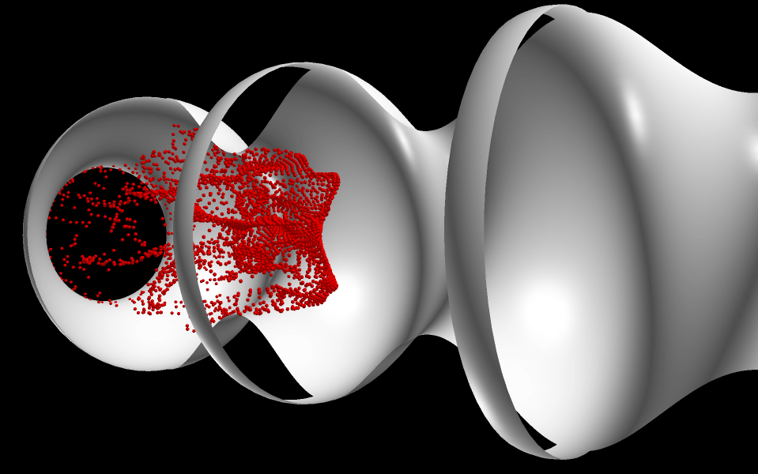
Outline of the Tutorial
Overview of parallel programming
Introduction to Global Arrays programming model
Basic GA commands
Intermediate commands
Advanced features
Current and future developments in GA

Slide 4
Why Parallel?
When to Parallelize:
Program takes too long to execute on a single processor
Program requires too much memory to run on a single processor
Program contains multiple elements that are executed or could be executed independently of each other
Advantages of parallel programs:
Single processor performance is not increasing. The only way to improve performance is to write parallel programs.
Data and operations can be distributed amongst N processors instead of 1 processor. Codes execute potentially N times as quickly.
Disadvantages of parallel programs:
Greater program complexity

Slide 5
Parallel vs Serial
Parallel codes can divide the work and memory required for application execution amongst multiple processors
New costs are introduced into parallel codes:
Communication
Code complexity
New dependencies

Slide 6
Communication
Parallel applications require data to be communicated from one processor to another at some point
Data can be communicated by having processors exchanging data via messages (message-passing)
Data can be communicated by having processors directly write or read data in another processors memory (one-sided)

Slide 7
Data Transfers
The amount of time required to transfer data consists of two parts
Latency: the time to initiate data transfer, independent of data size
Transfer time: the time to actually transfer data once the transfer is started, proportional to data size
Latency
Data Transfer
Because of latency costs, a single large message is preferred over many small messages

Slide 8
Parallel Efficiency
Strong Scaling:
For a given size problem, the time to execute is inversely proportional to the number of processors used. If you want to get your answers faster, you want a strong scaling program.
Weak Scaling:
If the problem size increases in proportion to the number of processors, the execution time is constant. If you want to run larger calculations, you are looking for weak scaling.
Speedup:
The ratio of the execution time on N processors to the execution time on 1 processor. If your code is linearly scaling (the best case) then speedup is equal to the number of processors.
Strong Scaling and Weak Scaling are not incompatible. You can have both.

Slide 9
Sources of Parallel Inefficiency
Communication
Message latency is a constant regardless of number of processors
Not all message sizes decrease with increasing numbers of processors
Number of messages per processor may increase with number of processors, particularly for global operations such as synchronizations, etc.
Load Imbalance
Some processors are assigned more work than others resulting in processors that are idle
OS jitter
Note: parallel inefficiency is inevitable at sufficiently large processor counts. The goal of parallel code development is to put off as long as possible the point at which the inefficiencies dominate.

Slide 10
Increasing Scalability
Design algorithms to minimize communication
Exploit data locality
Aggregate messages
Overlapping computation and communication
On most high end platforms, computation and communication use non-overlapping resources. Communication can occur simultaneously with computation
One-sided non-blocking communication and double buffering
Load balancing
Static load balancing: partition calculation at startup so that each processor has approximately equal work
Dynamic load balancing: structure algorithm to repartition work while calculation is running. Note that dynamic load balancing generally increases the other source of parallel inefficiency, communication.

Slide 11
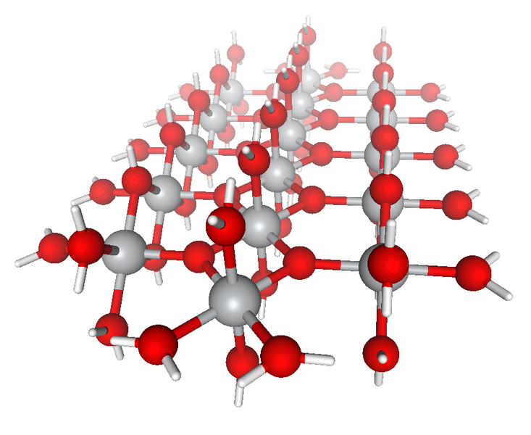
Outline of the Tutorial
Overview of parallel programming
Introduction to Global Arrays programming model
Basic GA commands
Advanced features of the GA Toolkit
Current and future developments in GA

Slide 12
Distributed Data vs Shared Memory
Shared Memory:
Data is in a globally accessible address space, any processor can access data by specifying its location using a global index
Data is mapped out in a natural manner (usually corresponding to the original problem) and access is easy. Information on data locality is obscured and leads to loss of performance.
(1,1)
(47,95)
(106,171)
(150,200)

Slide 13
Distributed vs Shared Data View
Distributed Data:
Data is explicitly associated with each processor, accessing data requires specifying the location of the data on the processor and the processor itself.
Data locality is explicit but data access is complicated. Distributed computing is typically implemented with message passing (e.g. MPI)
(0xf5670,P0)
(0xf32674,P5)
P0
P1
P2

Slide 14
Global Arrays
Distributed dense arrays that can be accessed using a
shared memory-like style
Physically distributed data
single, shared data structure/ global indexing
e.g., access A(4,3) rather than buf(7) on task 2
Global Address Space

Slide 15
Creating Global Arrays
integer array handle
minimum block size on each processor
character string
g_a = NGA_Create(type, ndim, dims, name, chunk)
float, double, int, etc.
array of dimensions
dimension

Slide 16
One-sided Communication
Message Passing:
Message passing requires cooperation on both sides. The processor sending the message (P1) and the processor receiving the message (P0) must both participate.
receive
send
P0
P1
message passing
MPI
One-sided Communication:
Once message is initiated on sending processor (P1) the sending processor can continue computation. Receiving processor (P0) is not involved. Data is copied directly from switch into memory on P0.
put
P0
P1
one-sided communication
SHMEM, ARMCI, MPI-2-1S

Slide 17
Remote Data Access in GA vs MPI
Message Passing:
identify size and location of data blocks
loop over processors:
if (me = P_N) then
pack data in local message buffer
send block of data to message buffer on P0
else if (me = P0) then
receive block of data from P_N in message buffer
unpack data from message buffer to local buffer
endif
end loop
copy local data on P0 to local buffer
Global Arrays:
NGA_Get(g_a, lo, hi, buffer, ld);
}
}
Global Array handle
Global upper and lower indices of data patch
Local buffer and array of strides
P0
P2
P1
P3

Slide 18
Onesided vs Message Passing
Message-passing
Communication patterns are regular or at least predictable
Algorithms have a high degree of synchronization
Data consistency is straightforward
One-sided
Communication is irregular
Load balancing
Algorithms are asynchronous
But also can be used for synchronous algorithms
Data consistency must be explicitly managed

Slide 19
Global Array Model of Computations
Shared Object
Shared Object
copy to shared object
get
put
copy to local memory
compute/update
local memory
local memory
local memory

Slide 20
Global Arrays vs. Other Models
Advantages:
Inter-operates with MPI
Use more convenient global-shared view for multi-dimensional arrays, but can use MPI model wherever needed
Data-locality and granularity control is explicit with GA’s get-compute-put model, unlike the non-transparent communication overheads with other models (except MPI)
Library-based approach: does not rely upon smart compiler optimizations to achieve high performance
Disadvantage:
Data consistency must be explicitly managed

Slide 21
Global Arrays (cont.)
Shared data model in context of distributed dense arrays
Much simpler than message-passing for many applications
Complete environment for parallel code development
Compatible with MPI
Data locality control similar to distributed memory/message passing model
Extensible
Scalable

Slide 22
Data Locality in GA
What data does a processor own?
NGA_Distribution(g_a, iproc, lo, hi);
Where is the data?
NGA_Access(g_a, lo, hi, ptr, ld)
Use this information to organize calculation so that maximum use is made of locally held data

Slide 23
Example: Matrix Multiply
global arrays representing matrices
=
•
nga_put
nga_get
=
•
dgemm
local buffers on the processor

Slide 24
Matrix Multiply (a better version)
more scalable!
(less memory, higher parallelism)
=
•
atomic accumulate
get
=
•
dgemm
local buffers on the processor

Slide 25
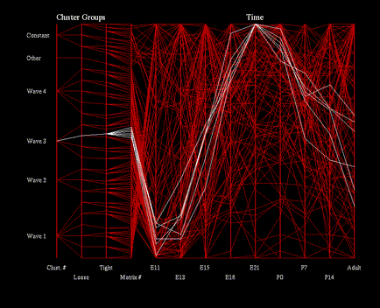
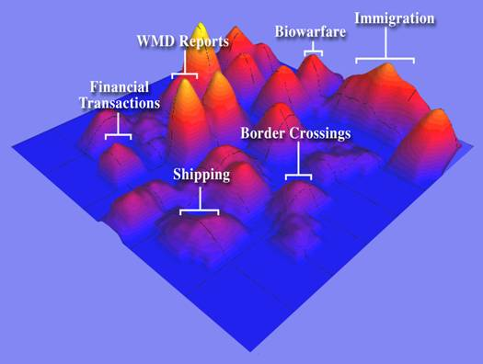
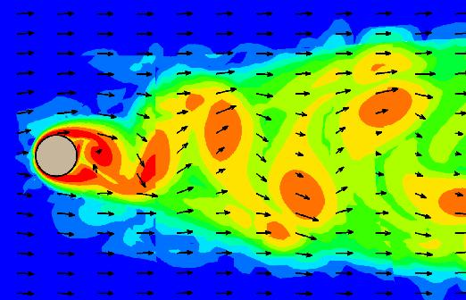
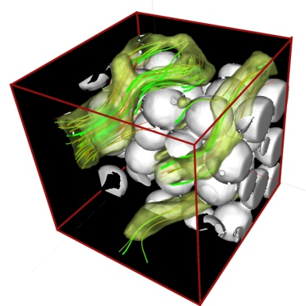
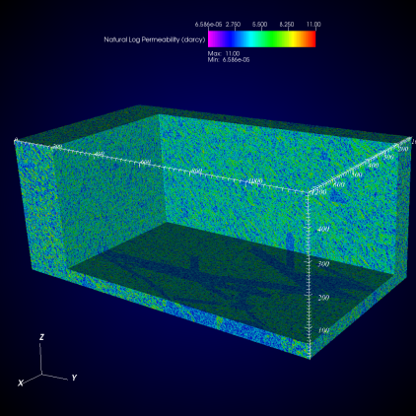
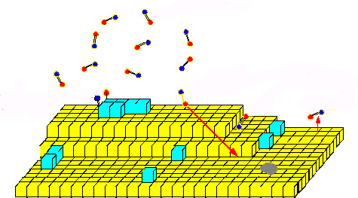
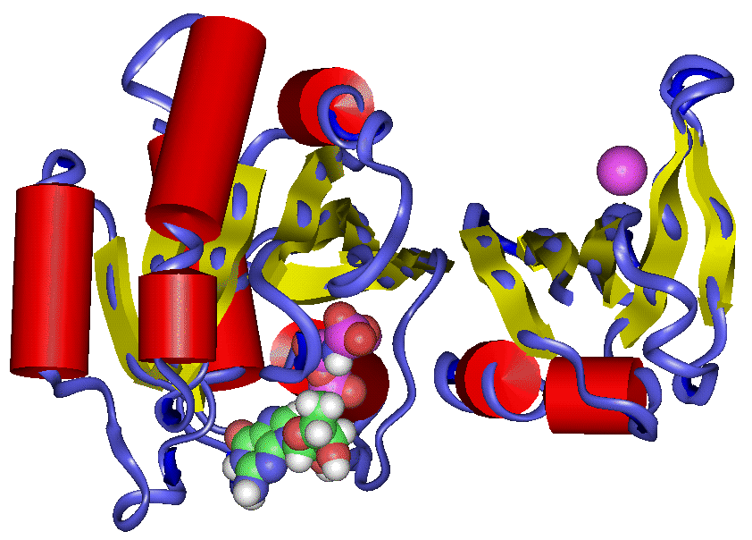
Application Areas
electronic structure chemistry
Major area
bioinformatics
fluid dynamics
visual analytics
smoothed particle hydrodynamics
hydrology
material sciences
molecular dynamics
Others: financial security forecasting, astrophysics, biology, climate analysis

Slide 26
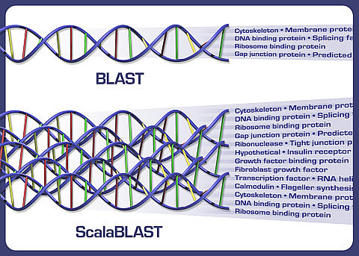
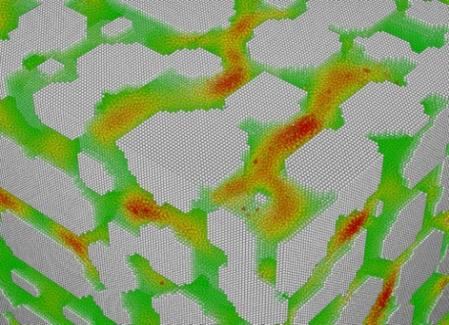
Recent Applications
ScalaBLAST
C. Oehmen and J. Nieplocha. ScalaBLAST: "A scalable implementation of BLAST for high performance data-intensive bioinformatics analysis." IEEE Trans. Parallel Distributed Systems, Vol. 17, No. 8, 2006
Parallel Inspire
Krishnan M, SJ Bohn, WE Cowley, VL Crow, and J Nieplocha,
"Scalable Visual Analytics of Massive Textual Datasets",
Proc. IEEE International Parallel and Distributed
Processing Symposium, 2007.
Smooth Particle Hydrodynamics
B. Palmer, V. Gurumoorthi, A. Tartakovsky, T. Scheibe, A Component-Based Framework for Smoothed Particle Hydrodynamics Simulations of Reactive Fluid Flow in Portous Media”, Int. J. High Perf. Comput. App., Vol 24, 2010

Slide 27
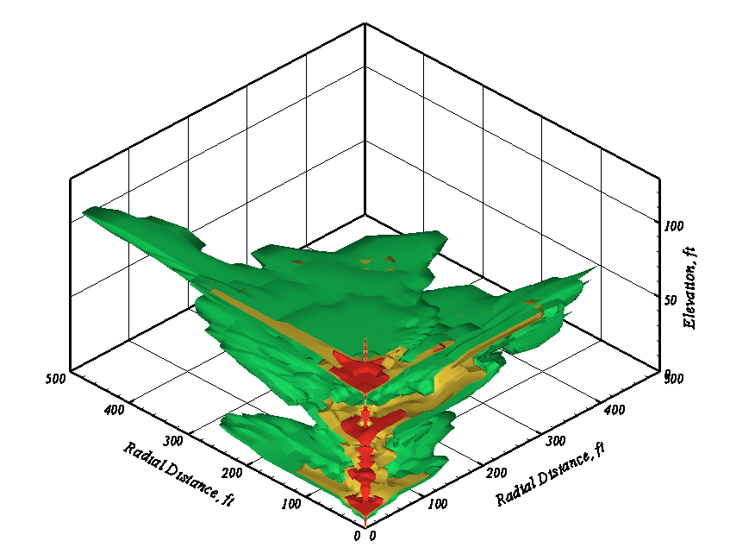
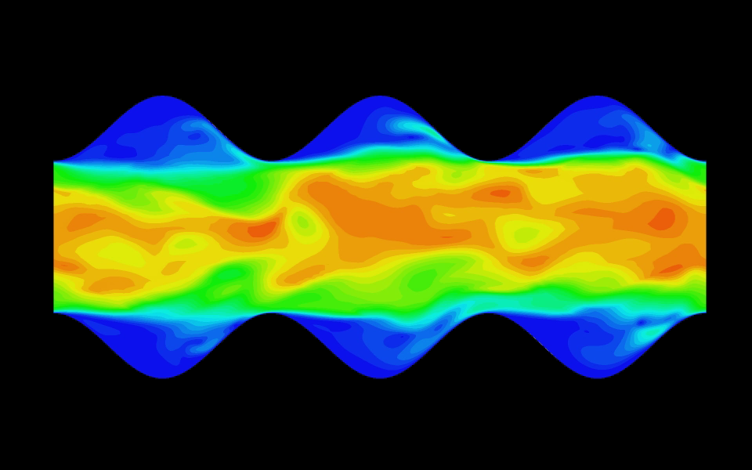
Recent Applications
Subsurface Transport Over Multiple Phases: STOMP
Transient Energy Transport Hydrodynamics Simulator: TETHYS

Slide 28
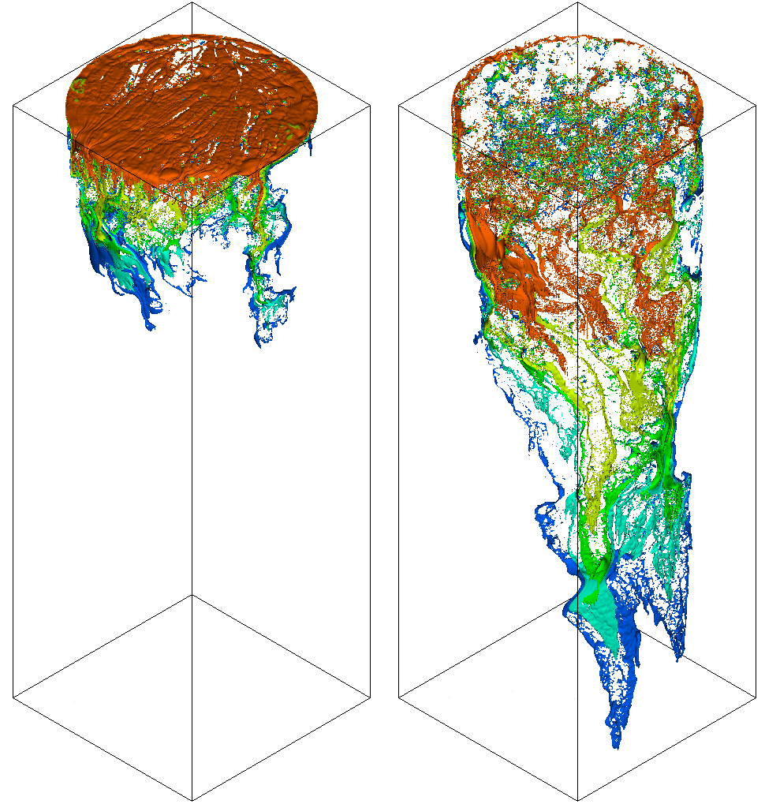
Outline of the Tutorial
Overview of parallel programming
Introduction to Global Arrays programming model
Basic GA commands
Intermiate commands
Advanced features
Current and future developments in GA

Slide 29
Structure of GA
Application programming language interface
Fortran
C
C++
Python
distributed arrays layer
memory management, index translation
Global Arrays and MPI are completely interoperable. Code can contain calls to both libraries.
MPI
Global
operations
ARMCI
portable 1-sided communication
put, get, locks, etc
system specific interfaces
LAPI, Infiniband, threads, VIA,..

Slide 30
Writing GA Programs
#include <stdio.h>
#include "mpi.h"
#include "ga.h"
#include "macdecls.h"
int main( int argc, char **argv ) {
MPI_Init( &argc, &argv );
GA_Initialize();
printf( "Hello world\n" );
GA_Terminate();
MPI_Finalize();
return 0;
}
GA requires the following functionalities from a message passing library (MPI/TCGMSG)
initialization and termination of processes
Broadcast, Barrier
a function to abort the running parallel job in case of an error
The message-passing library has to be
initialized before the GA library
terminated after the GA library is terminated
GA is compatible with MPI

Slide 31
Source Code and More Information
Version 5.0.2 available
Homepage at http://www.emsl.pnl.gov/docs/global/
Platforms
IBM SP, BlueGene
Cray XT, XE6 (Gemini)
Linux Cluster with Ethernet, Infiniband
Solaris
Fujitsu
Hitachi
NEC
HP
Windows

Slide 32
Documentation on Writing, Building and Running GA programs
For detailed information
GA Webpage
GA papers, APIs, user manual, etc.
(Google: Global Arrays)
http://www.emsl.pnl.gov/docs/global/
GA User Manual
http://www.emsl.pnl.gov/docs/global/user.html
GA API Documentation
GA Webpage => User Interface
http://www.emsl.pnl.gov/docs/global/userinterface.html
GA Support/Help
hpctools@pnl.gov or hpctools@emsl.pnl.gov
2 mailing lists: GA User Forum, and GA Announce

Slide 33
Installing GA
GA 5.0 established autotools (configure && make && make install) for building
No environment variables are required
Traditional configure env vars CC, CFLAGS, CPPFLAGS, LIBS, etc
Specify the underlying network communication protocol
Only required on clusters with a high performance network
e.g. If the underlying network is Infiniband using OpenIB protocol use: configure --with-openib
GA requires MPI for basic start-up and process management
You can either use MPI or TCGMSG wrapper to MPI
MPI is the default: configure
TCGMSG-MPI wrapper: configure --with-mpi --with-tcgmsg
TCGMSG: configure --with-tcgmsg
Various “make” targets
“make” to build GA libraries
“make install” to install libraries
“make checkprogs” to build tests and examples
“make check MPIEXEC=‘mpiexec -np 4’” to run test suite
VPATH builds: one source tree, many build trees i.e. configurations

Slide 34
Compiling and Linking GA Programs
Your Makefile: Please refer to the CFLAGS, FFLAGS, CPPFLAGS, LDFLAGS and LIBS variables, which will be printed if you “make flags”.
# ===========================================================================
# Suggested compiler/linker options are as follows.
# GA libraries are installed in /Users/d3n000/ga/ga-5-0/bld_openmpi_shared/lib
# GA headers are installed in /Users/d3n000/ga/ga-5-0/bld_openmpi_shared/include
#
CPPFLAGS="-I/Users/d3n000/ga/ga-5-0/bld_openmpi_shared/include"
#
LDFLAGS="-L/Users/d3n000/ga/ga-5-0/bld_openmpi_shared/lib"
#
# For Fortran Programs:
FFLAGS="-fdefault-integer-8"
LIBS="-lga -framework Accelerate"
#
# For C Programs:
CFLAGS=""
LIBS="-lga -framework Accelerate -L/usr/local/lib/gcc/x86_64-apple-darwin10/4.6.0 -L/usr/local/lib/gcc/x86_64-apple-darwin10/4.6.0/../../.. -lgfortran"
# ===========================================================================
You can use these variables in your Makefile:
For example: gcc $(CPPLAGS) $(LDFLAGS) -o ga_test ga_test.c $(LIBS)

Slide 35
Writing GA Programs
GA Definitions and Data types
C programs include files: ga.h, macdecls.h
Fortran programs should include the files: mafdecls.fh, global.fh.
#include <stdio.h>
#include "mpi.h“
#include "ga.h"
#include "macdecls.h"
int main( int argc, char **argv ) {
/* Parallel program */
}

Slide 36
Running GA Programs
Example: Running a test program “ga_test” on 2 processes for GA built using the MPI runtime
mpirun -np 2 ga_test
Running a GA program is same as MPI

Slide 37
11 Basic GA Operations
GA programming model is very simple.
Most of a parallel program can be written with these basic calls
GA_Initialize, GA_Terminate
GA_Nnodes, GA_Nodeid
GA_Create, GA_Destroy
GA_Put, GA_Get
GA Distribution, GA_Access
GA_Sync

Slide 38



GA Initialization/Termination
program main
#include “mafdecls.fh”
#include “global.fh”
integer ierr
c
call mpi_init(ierr)
call ga_initialize()
c
write(6,*) ‘Hello world’
c
call ga_terminate()
call mpi_finalize()
end
There are two functions to initialize GA:
Fortran
subroutine ga_initialize()
subroutine ga_initialize_ltd(limit)
C
void GA_Initialize()
void GA_Initialize_ltd(size_t limit)
Python
import ga, then ga.set_memory_limit(limit)
To terminate a GA program:
Fortran subroutine ga_terminate()
C void GA_Terminate()
Python N/A

Slide 39
Parallel Environment - Process Information
Parallel Environment:
how many processes are working together (size)
what their IDs are (ranges from 0 to size-1)
To return the process ID of the current process:
Fortran integer function ga_nodeid()
C int GA_Nodeid()
Python nodeid = ga.nodeid()
To determine the number of computing processes:
Fortran integer function ga_nnodes()
C int GA_Nnodes()
Python nnodes = ga.nnodes()

Slide 40
Parallel Environment - Process Information (EXAMPLE)
$ mpirun –np 4 helloworld
Hello world: My rank is 0 out of 4 processes/nodes
Hello world: My rank is 2 out of 4 processes/nodes
Hello world: My rank is 3 out of 4 processes/nodes
Hello world: My rank is 1 out of 4 processes/nodes
program main
#include “mafdecls.fh”
#include “global.fh”
integer ierr,me,nproc
call mpi_init(ierr)
call ga_initialize()
me = ga_nodeid()
size = ga_nnodes()
write(6,*) ‘Hello world: My rank is ’ + me + ‘ out of ‘ +
& size + ‘processes/nodes’
call ga_terminate()
call mpi_finilize()
end
$ mpirun –np 4 python helloworld.py
Hello world: My rank is 0 out of 4 processes/nodes
Hello world: My rank is 2 out of 4 processes/nodes
Hello world: My rank is 3 out of 4 processes/nodes
Hello world: My rank is 1 out of 4 processes/nodes

Slide 41
GA Data Types
C Data types
C_INT - int
C_LONG - long
C_FLOAT - float
C_DBL - double
C_SCPL - single complex
C_DCPL - double complex
Fortran Data types
MT_F_INT - integer (4/8 bytes)
MT_F_REAL - real
MT_F_DBL - double precision
MT_F_SCPL - single complex
MT_F_DCPL - double complex

Slide 42
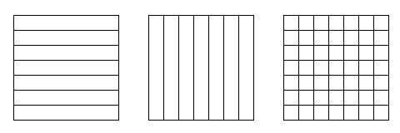
Creating/Destroying Arrays
To create an array with a regular distribution:
Fortran logical function nga_create(type, ndim, dims, name,
chunk, g_a)
C int NGA_Create(int type, int ndim, int dims[],
char *name, int chunk[])
Python g_a = ga.create(type, dims, name="", chunk=None,
int pgroup=-1)
character*(*) name - a unique character string [input]
integer type - GA data type [input]
integer dims() - array dimensions [input]
integer chunk() - minimum size that dimensions should be chunked into [input]
integer g_a - array handle for future references [output]
dims(1) = 5000
dims(2) = 5000
chunk(1) = -1 !Use defaults
chunk(2) = -1
if (.not.nga_create(MT_F_DBL,2,dims,’Array_A’,chunk,g_a))
+ call ga_error(“Could not create global array A”,g_a)

Slide 43
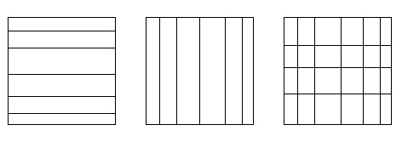
Creating/Destroying Arrays (cont.)
To create an array with an irregular distribution:
Fortran logical function nga_create_irreg (type, ndim,
dims, array_name, map, nblock, g_a)
C int NGA_Create_irreg(int type, int ndim, int dims[], char* array_name, nblock[], map[])
Python g_a = ga.create_irreg(int gtype, dims, block, map,
name="", pgroup=-1)
character*(*) name - a unique character string [input]
integer type - GA datatype [input]
integer dims - array dimensions [input]
integer nblock(*) - no. of blocks each dimension is divided into [input]
integer map(*) - starting index for each block [input]
integer g_a - integer handle for future references [output]

Slide 44
Creating/Destroying Arrays (cont.)
Example of irregular distribution:
The distribution is specified as a Cartesian product of distributions for each dimension. The array indices start at 1.
The figure demonstrates distribution of a 2-dimensional array 8x10 on 6 (or more) processors. block[2]={3,2}, the size of map array is s=5 and array map contains the following elements map={1,3,7, 1, 6}.
The distribution is nonuniform because, P1 and P4 get 20 elements each and processors P0,P2,P3, and P5 only 10 elements each.
5
5
block(1) = 3
block(2) = 2
map(1) = 1
map(2) = 3
map(3) = 7
map(4) = 1
map(5) = 6
if (.not.nga_create_irreg(MT_F_DBL,2,dims, &
’Array_A’,map,block,g_a)) &
call ga_error(“Could not create array A”,g_a)
P0
P3
2
P1
P4
4
P2
P5
2

Slide 45
Creating/Destroying Arrays (cont.)
To duplicate an array:
Fortran logical function ga_duplicate(g_a, g_b, name)
C int GA_Duplicate(int g_a, char *name)
Python ga.duplicate(g_a, name)
Global arrays can be destroyed by calling the function:
Fortran subroutine ga_destroy(g_a)
C void GA_Destroy(int g_a)
Python ga.destroy(g_a)
integer g_a, g_b;
character*(*) name;
name - a character string [input]
g_a - Integer handle for reference array [input]
g_b - Integer handle for new array [output]
call nga_create(MT_F_INT,dim,dims,
+ ‘array_a’,chunk,g_a)
call ga_duplicate(g_a,g_b,‘array_b’)
call ga_destroy(g_a)

Slide 46
Put/Get
Put copies data from a local array to a global array section:
Fortran subroutine nga_put(g_a, lo, hi, buf, ld)
C void NGA_Put(int g_a, int lo[], int hi[], void *buf, int ld[])
Python ga.put(g_a, buf, lo=None, hi=None)
Get copies data from a global array section to a local array:
Fortran subroutine nga_get(g_a, lo, hi, buf, ld)
C void NGA_Get(int g_a, int lo[], int hi[], void *buf, int ld[])
Python buffer = ga.get(g_a, lo, hi, numpy.ndarray buffer=None)
integer g_a global array handle [input]
integer lo(),hi() limits on data block to be moved [input]
Double precision/complex/integer buf local buffer [output]
integer ld() array of strides for local buffer [input]

Slide 47
Put/Get (cont.)
Example of put operation:
transfer data from a local buffer (10 x10 array) to (7:15,1:8) section of a 2-dimensional 15 x10 global array into lo={7,1}, hi={15,8}, ld={10}
global
double precision buf(10,10)
:
:
call nga_put(g_a,lo,hi,buf,ld)
lo
local
hi

Slide 48
Atomic Accumulate
Accumulate combines the data from the local array with data in the global array section:
Fortran subroutine nga_acc(g_a, lo, hi,
buf, ld, alpha)
C void NGA_Acc(int g_a, int lo[], int hi[], void *buf, int ld[], void *alpha)
Python ga.acc(g_a, buffer, lo=None, hi=None,
alpha=None)
integer g_a array handle [input]
integer lo(), hi() limits on data block to be moved [input]
double precision/complex buf local buffer [input]
integer ld() array of strides for local buffer [input]
double precision/complex alpha arbitrary scale factor [input]

Slide 49
Atomic Accumulate (cont)
global
local
ga(i,j) = ga(i,j)+alpha*buf(k,l)

Slide 50
Sync
Sync is a collective operation
It acts as a barrier, which synchronizes all the processes and ensures that all outstanding Global Array operations are complete at the call
The functions are:
Fortran subroutine ga_sync()
C void GA_Sync()
Python ga.sync()
GA_sync is the main mechanism in GA for guaranteeing data consistency
sync

Slide 51
Global Operations
Fortran subroutine ga_brdcst(type, buf, lenbuf, root)
subroutine ga_igop(type, x, n, op)
subroutine ga_dgop(type, x, n, op)
C void GA_Brdcst(void *buf, int lenbuf, int root)
void GA_Igop(long x[], int n, char *op)
void GA_Dgop(double x[], int n, char *op)
Python buffer = ga.brdcst(buffer, root)
buffer = ga.gop(x, op)

Slide 52
Global Array Model of Computations
Shared Object
Shared Object
copy to shared object
get
put
copy to local memory
compute/update
local memory
local memory
local memory

Slide 53
Locality Information
Discover array elements held by each processor
Fortran nga_distribution(g_a,proc,lo,hi)
C void NGA_Distribution(int g_a, int proc, int *lo, int *hi)
Python lo,hi = ga.distribution(g_a, proc=-1)
integer g_a array handle [input]
integer proc processor ID [input]
integer lo(ndim) lower index [output]
integer hi(ndim) upper index [output]
do iproc = 1, nproc
write(6,*) ‘Printing g_a info for processor’,iproc
call nga_distribution(g_a,iproc,lo,hi)
do j = 1, ndim
write(6,*) j,lo(j),hi(j)
end do
dnd do

Slide 54
Example: Matrix Multiply
/* Determine which block of data is locally owned. Note that
the same block is locally owned for all GAs. */
NGA_Distribution(g_c, me, lo, hi);
/* Get the blocks from g_a and g_b needed to compute this block in
g_c and copy them into the local buffers a and b. */
lo2[0] = lo[0]; lo2[1] = 0; hi2[0] = hi[0]; hi2[1] = dims[0]-1;
NGA_Get(g_a, lo2, hi2, a, ld);
lo3[0] = 0; lo3[1] = lo[1]; hi3[0] = dims[1]-1; hi3[1] = hi[1];
NGA_Get(g_b, lo3, hi3, b, ld);
/* Do local matrix multiplication and store the result in local
buffer c. Start by evaluating the transpose of b. */
for(i=0; i < hi3[0]-lo3[0]+1; i++)
for(j=0; j < hi3[1]-lo3[1]+1; j++)
btrns[j][i] = b[i][j];
/* Multiply a and b to get c */
for(i=0; i < hi[0] - lo[0] + 1; i++) {
for(j=0; j < hi[1] - lo[1] + 1; j++) {
c[i][j] = 0.0;
for(k=0; k<dims[0]; k++)
c[i][j] = c[i][j] + a[i][k]*btrns[j][k];
}
}
/* Copy c back to g_c */
NGA_Put(g_c, lo, hi, c, ld);
=
•
nga_put
nga_get
=
•
dgemm

Slide 55
New Interface for Creating Arrays
Developed to handle the proliferating number of properties that can be assigned to Global Arrays
Fortran integer function ga_create_handle()
subroutine ga_set_data(g_a, dim, dims, type)
subroutine ga_set_array_name(g_a, name)
subroutine ga_set_chunk(g_a, chunk)
subroutine ga_set_irreg_distr(g_a, map, nblock)
subroutine ga_set_ghosts(g_a, width)
subroutine ga_set_block_cyclic(g_a, dims)
subroutine ga_set_block_cyclic_proc_grid(g_a,
dims, proc_grid)
logical function ga_allocate(g_a)

Slide 56
New Interface for Creating Arrays
C int GA_Create_handle()
void GA_Set_data(int g_a, int dim, int *dims,
int type)
void GA_Set_array_name(int g_a, char* name)
void GA_Set_chunk(int g_a, int *chunk)
void GA_Set_irreg_distr(int g_a, int *map,
int *nblock)
void GA_Set_ghosts(int g_a, int *width)
void GA_Set_block_cyclic(int g_a, int *dims)
void GA_Set_block_cyclic_proc_grid(int g_a, int *dims,
int *proc_grid)
int GA_Allocate(int g_a)

Slide 57
New Interface for Creating Arrays
Python handle = ga.create_handle()
ga.set_data(g_a, dims, type)
ga.set_array_name(g_a, name)
ga.set_chunk(g_a, chunk)
ga.set_irreg_distr (g_a, map, nblock)
ga.set_ghosts(g_a, width)
ga.set_block_cyclic(g_a, dims)
ga.set_block_cyclic_proc_grid(g_a, dims,
proc_grid)
bool ga.allocate(int g_a)

Slide 58
New Interface for Creating Arrays (Cont.)
integer ndim,dims(2),chunk(2)
integer g_a, g_b
logical status
c
ndim = 2
dims(1) = 5000
dims(2) = 5000
chunk(1) = 100
chunk(2) = 100
c
c Create global array A using old interface
c
status = nga_create(MT_F_DBL, ndim, dims, chunk, ‘array_A’, g_a)
c
c Create global array B using new interface
C
g_b = ga_create_handle()
call ga_set_data(g_b, ndim, dims, MT_F_DBL)
call ga_set_chunk(g_b, chunk)
call ga_set_name(g_b, ‘array_B’)
call ga_allocate(g_b)

Slide 59
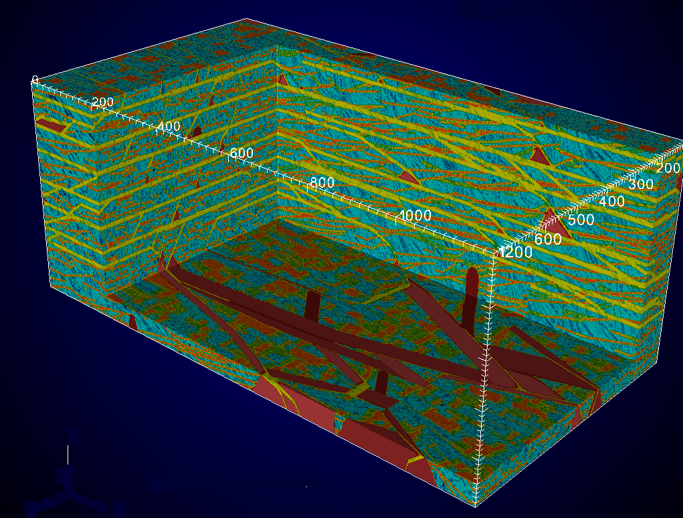
Outline of the Tutorial
Overview of parallel programming
Introduction to Global Arrays programming model
Basic GA commands
Intermediate commands
Advanced features
Current and future developments in GA

Slide 60
Basic Array Operations
Whole Arrays:
To set all the elements in the array to zero:
Fortran subroutine ga_zero(g_a)
C void GA_Zero(int g_a)
Python ga.zero(g_a)
To assign a single value to all the elements in array:
Fortran subroutine ga_fill(g_a, val)
C void GA_Fill(int g_a, void *val)
Python ga.fill(g_a, val)
To scale all the elements in the array by factorval:
Fortran subroutine ga_scale(g_a, val)
C void GA_Scale(int g_a, void *val)
Python ga.scale(g_a, val)

Slide 61
Basic Array Operations (cont.)
Whole Arrays:
To copy data between two arrays:
Fortran subroutine ga_copy(g_a, g_b)
C void GA_Copy(int g_a, int g_b)
Python ga.copy(g_a, g_b)
Arrays must be same size and dimension
Distribution may be different
call ga_create(MT_F_INT,ndim,dims,
‘array_A’,chunk_a,g_a)
call nga_create(MT_F_INT,ndim,dims,
‘array_B’,chunk_b,g_b)
... Initialize g_a ....
call ga_copy(g_a, g_b)
“g_a”
“g_b”
0
1
2
0
1
2
3
4
5
3
4
5
6
7
8
6
7
8
Global Arrays g_a and g_b distributed on a 3x3 process grid

Slide 62
Basic Array Patch Operations
Patch Operations:
The copy patch operation:
Fortran subroutine nga_copy_patch(trans, g_a, alo, ahi,
g_b, blo, bhi)
C void NGA_Copy_patch(char trans, int g_a,
int alo[], int ahi[], int g_b, int blo[], int bhi[])
Python ga.copy(g_a, g_b, alo=None, ahi=None,
blo=None, bhi=None, bint trans=False)
Number of elements must match
“g_a”
“g_b”
0
1
2
Copy
0
1
2
3
4
5
3
4
5
6
7
8
6
7
8

Slide 63
Basic Array Patch Operations (cont.)
Patches (Cont):
To set only the region defined by lo and hi to zero:
Fortran subroutine nga_zero_patch(g_a, lo, hi)
C void NGA_Zero_patch(int g_a, int lo[] int hi[])
Python ga.zero(g_a, lo=None, hi=None)
To assign a single value to all the elements in a patch:
Fortran subroutine nga_fill_patch(g_a, lo, hi, val)
C void NGA_Fill_patch(int g_a, int lo[], int hi[], void *val)
Python ga.fill(g_a, value, lo=None, hi=None)

Slide 64
Basic Array Patch Operations (cont.)
Patches (Cont):
To scale the patch defined by lo and hi by the factor val:
Fortran subroutine nga_scale_patch(g_a, lo, hi, val)
C void NGA_Scale_patch(int g_a, int lo[], int hi[],
void *val)
Python ga.scale(g_a, value, lo=None, hi=None)
The copy patch operation:
Fortran subroutine nga_copy_patch(trans, g_a, alo, ahi,
g_b, blo, bhi)
C void NGA_Copy_patch(char trans, int g_a,
int alo[], int ahi[], int g_b, int blo[], int bhi[])
Python ga.copy(g_a, g_b, alo=None, ahi=None,
blo=None, bhi=None, bint trans=False)

Slide 65
Scatter/Gather
Scatter puts array elements into a global array:
Fortran subroutine nga_scatter(g_a, v, subscrpt_array, n)
C void NGA_Scatter(int g_a, void *v, int *subscrpt_array[],
int n)
Python ga.scatter(g_a, values, subsarray)
Gather gets the array elements from a global array into a local array:
Fortran subroutine nga_gather(g_a, v, subscrpt_array, n)
C void NGA_Gather(int g_a, void *v, int *subscrpt_array[],
int n)
Python values = ga.gather(g_a, subsarray, numpy.ndarray
values=None)
integer g_a array handle [input]
double precision v(n) array of values [input/output]
integer n number of values [input]
integer subscrpt_array location of values in global array [input]

Slide 66
Scatter/Gather (cont.)
Example of scatter operation:
Scatter the 5 elements into a 10x10 global array
Element 1 v[0] = 5 subsArray[0][0] = 2 subsArray[0][1] = 3
Element 2 v[1] = 3 subsArray[1][0] = 3 subsArray[1][1] = 4
Element 3 v[2] = 8 subsArray[2][0] = 8 subsArray[2][1] = 5
Element 4 v[3] = 7 subsArray[3][0] = 3 subsArray[3][1] = 7
Element 5 v[4] = 2 subsArray[4][0] = 6 subsArray[4][1] = 3
After the scatter operation, the five elements would be scattered into the global array as shown in the figure.
 | 0 | 1 | 2 | 3 | 4 | 5 | 6 | 7 | 8 | 9
0
1
2 |  |  |  | 5
3 |  |  |  |  | 3 |  |  | 7
4
5
6 |  |  |  | 2
7
8 |  |  |  |  |  | 8
9
integer subscript(ndim,nlen)
:
call nga_scatter(g_a,v,subscript,nlen)

Slide 67
Read and Increment
Read_inc remotely updates a particular element in an integer global array and returns the original value:
Fortran integer function nga_read_inc(g_a, subscript, inc)
C long NGA_Read_inc(int g_a, int subscript[], long inc)
Python val = ga.read_inc(g_a, subscript, inc=1)
Applies to integer arrays only
Can be used as a global counter for dynamic load balancing
integer g_a [input]
integer subscript(ndim), inc [input]

Slide 68
Read and Increment (cont.)
c Create task counter
status = nga_create(MT_F_INT,one,one,chunk,g_counter)
call ga_zero(g_counter)
:
itask = nga_read_inc(g_counter,one,one)
... Translate itask into task ...
NGA_Read_inc
(Read and Increment)
Global Array
Global Lock
(access to data
is serialized)
Every integer value is read once and only once by some processor

Slide 69
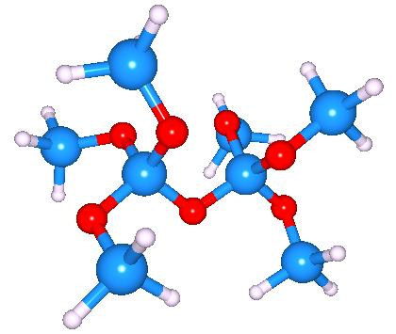
Hartree-Fock SCF
Obtain variational solutions to the electronic Schrödinger equation
within the approximation of a single Slater determinant.
Assuming the one electron orbitals are expanded as
the calculation reduces to the self-consistent eigenvalue problem

Slide 70
Parallelizing the Fock Matrix
The bulk of the work involves computing the 4-index elements (μν|ωλ). This is done by decomposing the quadruple loop into evenly sized blocks and assigning blocks to each processor using a global counter. After each processor completes a block it increments the counter to get the next block
do i
do j
do k
do l
F(i,j)=..
467
Read and increment counter
Accumulate results
Evaluate
block

Slide 71
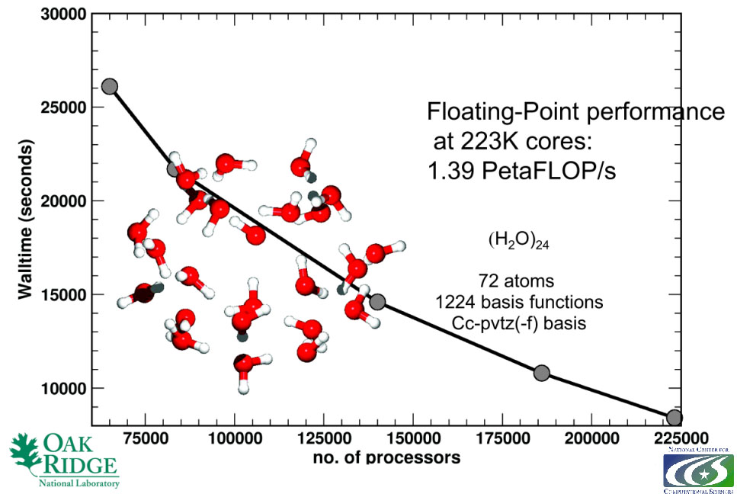
Gorden Bell finalist at SC09 - GA Crosses the Petaflop Barrier
GA-based parallel implementation of coupled cluster calculation performed at 1.39 petaflops using over 223,000 processes on ORNL's Jaguar petaflop system
Apra et. al., “Liquid water: obtaining the right answer for the right reasons”, SC 2009.
Global Arrays is one of two programming models that have achieved this level of performance

Slide 72
Direct Access to Local Data
Global Arrays support abstraction of a distributed array object
Object is represented by an integer handle
A process can access its portion of the data in the global array
To do this, the following steps need to be taken:
Find the distribution of an array, i.e. which part of the data the calling process owns
Access the data
Operate on the data: read/write
Release the access to the data
0
1
3
4

Slide 73
Access
To provide direct access to local data in the specified patch of the array owned by the calling process:
Fortran subroutine nga_access(g_a, lo, hi, index, ld)
C void NGA_Access(int g_a, int lo[], int hi[],
void *ptr, int ld[])
Python ndarray = ga.access(g_a, lo=None, hi=None)
Processes can access the local position of the global array
Process “0” can access the specified patch of its local position of the array
Avoids memory copy

Slide 74
Access (cont.)
status = nga_create(MT_F_DBL,2,dims,’Array’,chunk,g_a)
:
call nga_distribution(g_a,me,lo,hi)
call nga_access(g_a,lo,hi,index,ld)
call do_subroutine_task(dbl_mb(index),ld(1))
call nga_release(g_a,lo,hi)
subroutine do_subroutine_task(a,ld1)
double precision a(ld1,*)
0
1
2
Access: gives a pointer to this local patch
3
4
5
6
7
8

Slide 75
Non-blocking Operations
The non-blocking APIs are derived from the blocking interface by adding a handle argument that identifies an instance of the non-blocking request.
Fortran
subroutine nga_nbput(g_a, lo, hi, buf, ld, nbhandle)
subroutine nga_nbget(g_a, lo, hi, buf, ld, nbhandle)
subroutine nga_nbacc(g_a, lo, hi, buf, ld, alpha, nbhandle)
subroutine nga_nbwait(nbhandle)
C
void NGA_NbPut(int g_a, int lo[], int hi[], void *buf, int ld[], ga_nbhdl_t* nbhandle)
void NGA_NbGet(int g_a, int lo[], int hi[], void *buf, int ld[], ga_nbhdl_t* nbhandle)
void NGA_NbAcc(int g_a, int lo[], int hi[], void *buf, int ld[], void *alpha,
ga_nbhdl_t* nbhandle)
int NGA_NbWait(ga_nbhdl_t* nbhandle)
Python
handle = ga.nbput(g_a, buffer, lo=None, hi=None)
buffer,handle = ga.nbget(g_a, lo=None, hi=None, numpy.ndarray buffer=None)
handle = ga.nbacc(g_a, buffer, lo=None, hi=None, alpha=None)
ga.nbwait(handle)

Slide 76
Non-Blocking Operations
double precision buf1(nmax,nmax)
double precision buf2(nmax,nmax)
:
call nga_nbget(g_a,lo1,hi1,buf1,ld1,nb1)
ncount = 1
do while(.....)
if (mod(ncount,2).eq.1) then
... Evaluate lo2, hi2
call nga_nbget(g_a,lo2,hi2,buf2,nb2)
call nga_wait(nb1)
... Do work using data in buf1
else
... Evaluate lo1, hi1
call nga_nbget(g_a,lo1,hi1,buf1,nb1)
call nga_wait(nb2)
... Do work using data in buf2
endif
ncount = ncount + 1
end do

Slide 77
SRUMMA Matrix Multiplication
Issue NB Get A and B blocks
do (until last chunk)
issue NB Get to the next blocks
wait for previous issued call
compute A*B (sequential dgemm)
NB atomic accumulate into “C”
matrix
done
Computation
Comm.
(Overlap)
A
B
C=A.B
Advantages:
- Minimum memory
- Highly parallel
- Overlaps computation and communication
- latency hiding
- exploits data locality
- patch matrix multiplication (easy to use)
- dynamic load balancing
=
patch matrix multiplication
http://hpc.pnl.gov/projects/srumma/

Slide 78
SRUMMA Matrix Multiplication: Improvement over PBLAS/ScaLAPACK

Slide 79
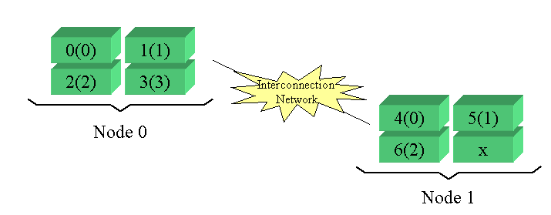
Cluster Information
Example:
2 nodes with 4 processors each. Say, there are 7 processes created.
ga_cluster_nnodes returns 2
ga_cluster_nodeid returns 0 or 1
ga_cluster_nprocs(inode) returns 4 or 3
ga_cluster_procid(inode,iproc) returns a processor ID

Slide 80
Cluster Information (cont.)
To return the total number of nodes that the program is running on:
Fortran integer function ga_cluster_nnodes()
C int GA_Cluster_nnodes()
Python nnodes = ga.cluster_nnodes()
To return the node ID of the process:
Fortran integer function ga_cluster_nodeid()
C int GA_Cluster_nodeid()
Python nodeid = ga.cluster_nodeid()
N0
N1

Slide 81
Cluster Information (cont.)
To return the number of processors available on node inode:
Fortran integer function ga_cluster_nprocs(inode)
C int GA_Cluster_nprocs(int inode)
Python nprocs = ga.cluster_nprocs(inode)
To return the processor ID associated with node inode and the local processor ID iproc:
Fortran integer function ga_cluster_procid(inode, iproc)
C int GA_Cluster_procid(int inode, int iproc)
Python procid = ga.cluster_procid(inode, iproc)
0(0)
1(1)
4(0)
5(1)
2(2)
3(3)
6(2)
7(3)

Slide 82
Accessing Processor Memory
Node
SMP Memory
R₈
R₉
R₁₀
R₁₁
ga_access
P₈
P₉
P₁₀
P₁₁

Slide 83
Processor Groups
To create a new processor group:
Fortran integer function ga_pgroup_create(list, size)
C int GA_Pgroup_create(int *list, int size)
Python pgroup = ga.pgroup_create(list)
To assign a processor groups:
Fortran logical function nga_create_config(
type, ndim, dims, name, chunk, p_handle, g_a)
C int NGA_Create_config(int type, int ndim, int dims[], char *name, int p_handle, int chunk[])
Python g_a = ga.create(type, dims, name, chunk, pgroup=-1)
integer g_a - global array handle [input]
integer p_handle - processor group handle [output]
integer list(size) - list of processor IDs in group [input]
integer size - number of processors in group [input]
]

Slide 84
Processor Groups
group A
group B
group C
world group

Slide 85
Processor Groups (cont.)
To set the default processor group
Fortran subroutine ga_pgroup_set_default(p_handle)
C void GA_Pgroup_set_default(int p_handle)
Python ga.pgroup_set_default(p_handle)
To access information about the processor group:
Fortran
integer function ga_pgroup_nnodes(p_handle)
integer function ga_pgroup_nodeid(p_handle)
C
int GA_Pgroup_nnodes(int p_handle)
int GA_Pgroup_nodeid(int p_handle)
Python
nnodes = ga.pgroup_nnodes(p_handle)
nodeid = ga.pgroup_nodeid(p_handle)
integer p_handle - processor group handle [input]

Slide 86
Processor Groups (cont.)
To determine the handle for a standard group at any point in the program:
Fortran
integer function ga_pgroup_get_default()
integer function ga_pgroup_get_mirror()
integer function ga_pgroup_get_world()
C
int GA_Pgroup_get_default()
int GA_Pgroup_get_mirror()
int GA_Pgroup_get_world() )
Python
p_handle = ga.pgroup_get_default()
p_handle = ga.pgroup_get_mirror()
p_handle = ga.pgroup_get_world()

Slide 87
Default Processor Group
c
c create subgroup p_a
c
p_a = ga_pgroup_create(list, nproc)
call ga_pgroup_set_default(p_a)
call parallel_task()
call ga_pgroup_set_default(ga_pgroup_get_world())
subroutine parallel_task()
p_b = ga_pgroup_create(new_list, new_nproc)
call ga_pgroup_set_default(p_b)
call parallel_subtask()

Slide 88
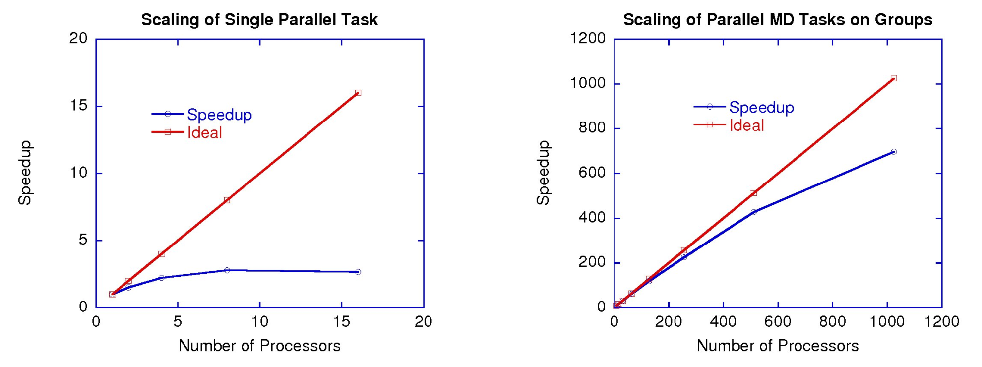
MD Application on Groups

Slide 89
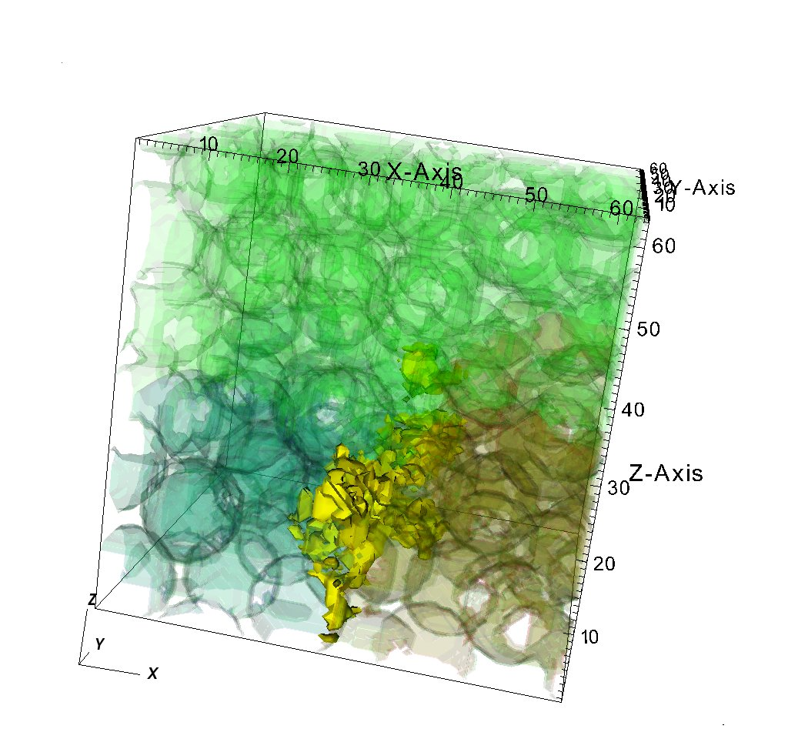
Outline of the Tutorial
Overview of parallel programming
Introduction to Global Arrays programming model
Basic GA commands
Intermediate commands
Advanced features
Current and future developments in GA

Slide 90
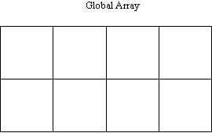
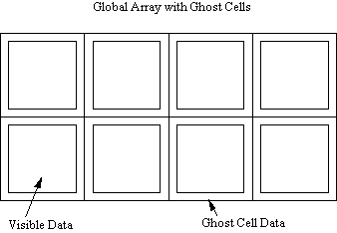
Creating Arrays with Ghost Cells
To create arrays with ghost cells:
For arrays with regular distribution:
Fortran logical function nga_create_ghosts(type, dims, width, array_name, chunk, g_a)
C int int NGA_Create_ghosts(int type, int ndim, int dims[], int width[], char *array_name, int chunk[])
Python g_a = ga.create_ghosts(type, dims, width,
name=“”, chunk=None, pgroup=-1)
For arrays with irregular distribution:
n-d Fortran logical function nga_create_ghosts_irreg(type, dims, width, array_name, map, block, g_a)
C int NGA_Create_ghosts_irreg(int type, int ndim, int dims[], int width[], char *array_name, int map[], int block[])
Python g_a = ga.create_ghosts_irreg(type, dims, width,
block, map, name=“”, pgroup=-1)
integer width(ndim) - array of ghost cell widths [input]
Code
Code

Slide 91
Ghost Cells
normal global array
global array with ghost cells
Operations:
NGA_Create_ghosts - creates array with ghosts cells
GA_Update_ghosts - updates with data from adjacent processors
NGA_Access_ghosts - provides access to “local” ghost cell elements
NGA_Nbget_ghost_dir - nonblocking call to update ghosts cells

Slide 92
Ghost Cell Update
Automatically update ghost cells with appropriate data from neighboring processors. A multiprotocol implementation has been used to optimize the update operation to match platform characteristics.

Slide 93
Periodic Interfaces
Periodic interfaces to the one-sided operations have been added to Global Arrays in version 3.1 to support computational fluid dynamics problems on multidimensional grids.
They provide an index translation layer that allows users to request blocks using put, get, and accumulate operations that possibly extend beyond the boundaries of a global array.
The references that are outside of the boundaries are wrapped around inside the global array.
Current version of GA supports three periodic operations:
periodic get
periodic put
periodic acc

Slide 94
Periodic Interfaces
global
ndim = 2
dims(1) = 10
dims(2) = 10
:
lo(1) = 6
lo(2) = 6
hi(1) = 11
hi(2) = 11
call nga_periodic_get(g_a,lo,hi,buf,ld)
local

Slide 95
Periodic Get/Put/Accumulate
Fortran subroutine nga_periodic_get(g_a, lo, hi, buf, ld)
C void NGA_Periodic_get(int g_a, int lo[], int hi[], void *buf, int ld[])
Python ndarray = ga.periodic_get(g_a, lo=None, hi=None, buffer=None)
Fortran subroutine nga_periodic_put(g_a, lo, hi, buf, ld)
C void NGA_Periodic_put(int g_a, int lo[], int hi[], void *buf, int ld[])
Python ga.periodic_put(g_a, buffer, lo=None, hi=None)
Fortran subroutine nga_periodic_acc(g_a, lo, hi, buf, ld, alpha)
C void NGA_Periodic_acc(int g_a, int lo[], int hi[], void *buf, int ld[],
void *alpha)
Python ga.periodic_acc(g_a, buffer, lo=None, hi=None, alpha=None)

Slide 96
Lock and Mutex
Lock works together with mutex.
Simple synchronization mechanism to protect a critical section
To enter a critical section, typically, one needs to:
Create mutexes
Lock on a mutex
Do the exclusive operation in the critical section
Unlock the mutex
Destroy mutexes
The create mutex functions are:
Fortran logical function ga_create_mutexes(number)
C int GA_Create_mutexes(int number)
Python bool ga.create_mutexes(number)

Slide 97
Lock and Mutex (cont.)
Lock
Unlock

Slide 98
Lock and Mutex (cont.)
The destroy mutex functions are:
Fortran logical function ga_destroy_mutexes()
C int GA_Destroy_mutexes()
Python bool ga.destroy_mutexes()
The lock and unlock functions are:
Fortran
subroutine ga_lock(int mutex)
subroutine ga_unlock(int mutex)
C
void GA_lock(int mutex)
void GA_unlock(int mutex)
Python
ga.lock(mutex)
ga.unlock(mutex)
integer mutex [input] ! mutex id

Slide 99
Fence
Fence blocks the calling process until all the data transfers corresponding to the Global Array operations initiated by this process complete
For example, since ga_put might return before the data reaches final destination, ga_init_fence and ga_fence allow process to wait until the data transfer is fully completed
ga_init_fence();
ga_put(g_a, ...);
ga_fence();
The initialize fence functions are:
Fortran subroutine ga_init_fence()
C void GA_Init_fence()
Python ga.init_fence()
The fence functions are:
Fortran subroutine ga_fence()
C void GA_Fence()
Python ga.fence()

Slide 100
Synchronization Control in Collective Operations
To eliminate redundant synchronization points:
Fortran subroutine ga_mask_sync(prior_sync_mask,
post_sync_mask)
C void GA_Mask_sync(int prior_sync_mask,
int post_sync_mask)
Python ga.mask_sync(prior_sync_mask, post_sync_mask)
logical first - mask (0/1) for prior internal synchronization [input]
logical last - mask (0/1) for post internal synchronization [input]
duplicate
status = ga_duplicate(g_a, g_b)
call ga_mask(0,1)
call ga_zero(g_b)
sync
duplicate
sync
sync
zero
sync
zero
sync
sync
sync

Slide 101
Linear Algebra
To add two arrays:
Fortran subroutine ga_add(alpha, g_a, beta, g_b, g_c)
C void GA_Add(void *alpha, int g_a, void *beta, int g_b, int g_c)
Python ga.add(g_a, g_b, g_c, alpha=None, beta=None,
alo=None, ahi=None, blo=None, bhi=None,
clo=None, chi=None)
To multiply arrays:
Fortran subroutine ga_dgemm(transa, transb, m, n, k, alpha, g_a, g_b,
beta, g_c)
C void GA_Dgemm(char ta, char tb, int m, int n, int k, double alpha, int g_a, int g_b, double beta, int g_c)
Python def gemm(bool ta, bool tb, m, n, k, alpha, g_a, g_b, beta, g_c)
double precision/complex/integer alpha, beta - scale factor [input]
integer g_a, g_b, g_c - array handles [input]
character*1 transa, transb [input]
integer m, n, k [input]

Slide 102
Linear Algebra (cont.)
To compute the element-wise dot product of two arrays:
Three separate functions for data types
Integer
Fortran ga_idot(g_a, g_b)
C GA_Idot(int g_a, int g_b)
Double precision
Fortran ga_ddot(g_a, g_b)
C GA_Ddot(int g_a, int g_b)
Double complex
Fortran ga_zdot(g_a, g_b)
C GA_Zdot(int g_a, int g_b)
Python has only one function: ga_dot(g_a, g_b)
integer g_a, g_b [input]
integer GA_Idot(int g_a, int g_b)
long GA_Ldot(int g_a, int g_b)
float GA_Fdot(int g_a, int g_b)
double GA_Ddot(int g_a, int g_b)
DoubleComplex GA_Zdot(int g_a, int g_b)

Slide 103
Linear Algebra (cont.)
To symmetrize a matrix:
Fortran subroutine ga_symmetrize(g_a)
C void GA_Symmetrize(int g_a)
Python ga.symmetrize(g_a)
To transpose a matrix:
Fortran subroutine ga_transpose(g_a, g_b)
C void GA_Transpose(int g_a, int g_b)
Python ga.transpose(g_a, g_b)

Slide 104
Linear Algebra on Patches
To add element-wise two patches and save the results into another patch:
Fortran subroutine nga_add_patch(alpha, g_a, alo, ahi, beta,
g_b, blo, bhi, g_c, clo, chi)
C void NGA_Add_patch(void *alpha, int g_a, int alo[], int ahi[],
void *beta, int g_b, int blo[], int bhi[], int g_c, int clo[], int chi[])
Python ga.add(g_a, g_b, g_c, alpha=None, beta=None,
alo=None, ahi=None, blo=None, bhi=None,
clo=None, chi=None)
integer g_a, g_b, g_c [input]
dbl prec/comp/int alpha, beta scale factors [input]
integer ailo, aihi, ajlo, ajhi g_a patch coord [input]
integer bilo, bihi, bjlo, bjhi g_b patch coord [input]
integer cilo, cihi, cjlo, cjhi g_c patch coord [input]

Slide 105
Linear Algebra on Patches (cont.)
To perform matrix multiplication:
Fortran subroutine ga_matmul_patch(transa, transb, alpha, beta,
g_a, ailo, aihi, ajlo, ajhi,
g_b, bilo, bihi, bjlo, bjhi,
g_c, cilo, cihi, cjlo, cjhi)
C void GA_Matmul_patch(char *transa, char* transb,
void* alpha, void *beta,
int g_a, int ailo, int aihi, int ajlo, int ajhi,
int g_b, int bilo, int bihi, int bjlo, int bjhi,
int g_c, int cilo, int cihi, int cjlo, int cjhi)
Fortran subroutine ga_matmul_patch(bool transa, bool transb,
alpha, beta,
g_a, ailo, aihi, ajlo, ajhi,
g_b, bilo, bihi, bjlo, bjhi,
g_c, cilo, cihi, cjlo, cjhi)
integer g_a, ailo, aihi, ajlo, ajhi patch of g_a [input]
integer g_b, bilo, bihi, bjlo, bjhi patch of g_b [input]
integer g_c, cilo, cihi, cjlo, cjhi patch of g_c [input]
dbl prec/comp alpha, beta scale factors [input]
character*1 transa, transb transpose flags [input]

Slide 106
Linear Algebra on Patches (cont.)
To compute the element-wise dot product of two arrays:
Three separate functions for data types
Integer
Fortran nga_idot_patch(g_a, ta, alo, ahi, g_b, tb, blo, bhi)
C NGA_Idot_patch(int g_a, char* ta,
int alo[], int ahi[], int g_b, char* tb, int blo[], int bhi[])
Double precision
Fortran nga_ddot_patch(g_a, ta, alo, ahi, g_b, tb, blo, bhi)
C NGA_Ddot_patch(int g_a, char* ta,
int alo[], int ahi[], int g_b, char* tb, int blo[], int bhi[])
Double complex
Fortran nga_zdot_patch(g_a, ta, alo, ahi, g_b, tb, blo, bhi)
C NGA_Zdot_patch(int g_a, char* ta,
int alo[], int ahi[], int g_b, char* tb, int blo[], int bhi[])
Python has only one function: ga.dot(g_a, g_b,
alo=None, ahi=None, blo=None, bhi=None, bint ta=False, bint tb=False)
integer g_a, g_b [input]
integer GA_Idot(int g_a, int g_b)
long GA_Ldot(int g_a, int g_b)
float GA_Fdot(int g_a, int g_b)
double GA_Ddot(int g_a, int g_b)
DoubleComplex GA_Zdot(int g_a, int g_b)

Slide 107
Block-Cyclic Data Distributions
Normal Data Distribution
Block-Cyclic Data Distribution

Slide 108
Block-Cyclic Data (cont.)
Simple Distribution
Scalapack Distribution
0
1
0
1
0
1
0
0
6
12
18
24
30
0,0
0,1
1
1
7
13
19
25
31
1,0
1,1
2
8
14
20
26
32
0
3
9
15
21
27
33
1
4
10
16
22
28
34
0
5
11
17
23
29
35
1
2 x 2 processor grid

Slide 109
Block-Cyclic Data (cont.)
Most operations work exactly the same, data distribution is transparent to the user
Some operations (matrix multiplication, non-blocking put, get) not implemented
Additional operations added to provide access to data associated with particular sub-blocks
You need to use the new interface for creating Global Arrays to get create block-cyclic data distributions

Slide 110
Creating Block-Cyclic Arrays
Must use new API for creating Global Arrays
Fortran subroutine ga_set_block_cyclic(g_a, dims)
subroutine ga_set_block_cyclic_proc_grid(g_a, dims,
proc_grid)
C void GA_Set_block_cyclic(int g_a, int dims[])
void GA_Set_block_cyclic_proc_grid(g_a, dims[], proc_grid[])
Python ga.set_block_cyclic(g_a, dims)
ga.set_block_cyclic_proc_grid(g_a, block, proc_grid)
integer dims[] - dimensions of blocks
integer proc_grid[] - dimensions of processor grid (note that product of all proc_grid dimensions

Slide 111
Block-Cyclic Methods
Methods for accessing data of individual blocks
Fortran subroutine ga_get_block_info(g_a, num_blocks, block_dims)
integer function ga_total_blocks(g_a)
subroutine nga_access_block_segment(g_a, iproc, index, length)
subroutine nga_access_block(g_a, idx, index, ld)
subroutine nga_access_block_grid(g_a, subscript, index, ld)
C void GA_Get_block_info(g_a, num_blocks[], block_dims[])
int GA_Total_blocks(int g_a)
void NGA_Access_block_segment(int g_a, int iproc, void *ptr, int *length)
void NGA_Access_block(int g_a, int idx, void *ptr, int ld[])
void NGA_Access_block_grid(int g_a, int subscript[], void *ptr, int ld[])
Python num_blocks,block_dims = ga.get_block_info(g_a)
blocks = ga.total_blocks(g_a)
ndarray = ga.access_block_segment(g_a, iproc)
ndarray = ga.access_block(g_a, idx)
ndarray = ga.access_block_grid(g_a, subscript)
integer length - total size of blocks held on processor
integer idx - index of block in array (for simple block-cyclic distribution)
integer subscript[] - location of block in block grid (for Scalapack distribution)

Slide 112
Sparse Data Manipulation
ga_scan_add
ga_scan_copy
g_mask: 1 0 0 0 0 0 1 0 1 0 0 1 0 0 1 1 0
g_src: 1 2 3 4 5 6 7 8 9 10 11 12 13 14 15 16 17
g_dest: 1 3 6 10 15 21 7 15 9 19 30 12 25 39 15 16 33
g_mask: 1 0 0 0 0 1 0 1 0 0 1 0 0 0 1 1 0
g_src: 5 8 7 3 2 6 9 7 3 4 8 2 3 6 9 10 7
g_dest: 5 5 5 5 5 6 6 7 7 7 8 8 8 8 9 10 10

Slide 113
Sparse Data Manipulation
ga_pack
ga_unpack
g_mask: 1 0 0 0 0 1 0 1 0 0 1 0 0 0 1 0 0
g_src: 1 2 3 4 5 6 7 8 9 10 11 12 13 14 15 16 17
g_dest: 1 6 8 11 15
g_mask: 1 0 0 0 0 1 0 1 0 0 1 0 0 0 1 0 0
g_src: 1 6 8 11 15
g_dest: 1 0 0 0 0 6 0 8 0 0 11 0 0 0 15 0 0

Slide 114
Compressed Sparse Row Matrix
VALUES: 1 3 2 5 7 9 3 4 5 2 6
J-INDEX: 3 4 1 5 2 4 1 3 5 2 5
I-INDEX: 1 3 5 7 10 12

Slide 115
Sparse Matrix-Vector Multiply
nga_access
nga_gather

Slide 116
Sparse Matrix-Vector Multiply
ga_elem_multiply
=
ga_scan_add
ga_pack

Slide 117
Data Mapping Information
0
4
8
To determine the process ID that owns the element defined by the array subscripts:
Fortran logical function nga_locate(g_a, subscript, owner)
C int NGA_Locate(int g_a, int subscript[])
Python proc = ga.locate(g_a, subscript)
integer g_a array handle [input]
Integer subscript(ndim) element subscript [input]
integer owner process id [output]
1
5
9
2
6
10
3
7
11
owner=5

Slide 118
Data Mapping Information (cont.)
0
4
8
To return a list of process IDs that own the patch:
Fortran logical function nga_locate_region(g_a, lo,
hi, map, proclist, np)
C int NGA_Locate_region(int g_a, int lo[],
int hi[], int *map[], int procs[])
Python map,procs = ga.locate_region(g_a, lo, hi)
integer np - number of processors that own a portion of block [output]
integer g_a - global array handle [input]
integer ndim - number of dimensions of the global array
integer lo(ndim) - array of starting indices for array section [input]
integer hi(ndim) - array of ending indices for array section [input]
integer map(2*ndim,*)- array with mapping information [output]
integer procs(np) - list of processes that own a part of array section [output]
1
5
9
2
6
10
3
7
11
procs = {0,1,2,4,5,6}
map = {lo₀₁,lo₀₂,hi₀₁,hi_{02,}
lo₁₁,lo₁₂,hi₁₁,hi₁₂,
lo₂₁,lo₂₂’hi₂₁,hi₂₂,
lo₄₁,lo₄₂,hi₄₁,hi₄₂,
lo₅₁,lo₅₂,hi₅₁,hi₅₂’
lo₆₁’lo₆₂,hi₆₁,hi₆₂}

Slide 119
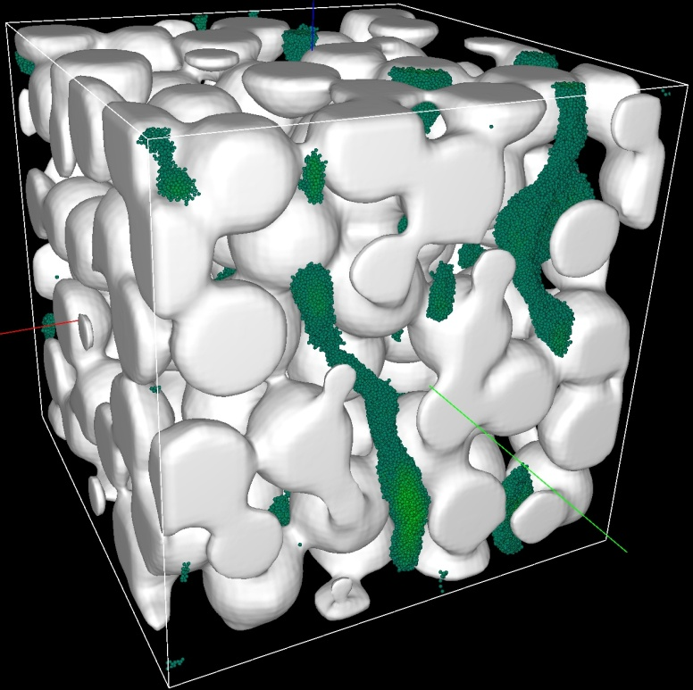
Outline of the Tutorial
Overview of parallel programming
Introduction to Global Arrays programming model
Basic GA commands
Intermediate commands
Advanced features
Current and future developments in GA

Slide 120
Profiling Capability
Weak bindings for ARMCI and GA API
Enable custom user wrappers to intercept these calls
ARMCI/GA support in TAU
On par with support for MPI
Available in current stable TAU release
Performance patterns for ARMCI in SCALASCA
Analysis of traces from ARMCI/GA programs
Available in an upcoming SCALASCA release
Consistent naming convention (NGA_)

Slide 121
Restricted Arrays
Create arrays in which only a few processors have data or arrays in which data is distributed to processors in a non-standard way
ga_set_restricted(g_a, list, nproc)
Process List
Global Array

Slide 122
Restricted Arrays
4 nodes, 16 processors
0
4
8
12
0
2
8
10
1
5
9
13
1
3
9
11
2
6
10
14
4
6
12
14
3
7
11
15
5
7
13
15
Standard data distribution
User-specified distribution

Slide 123
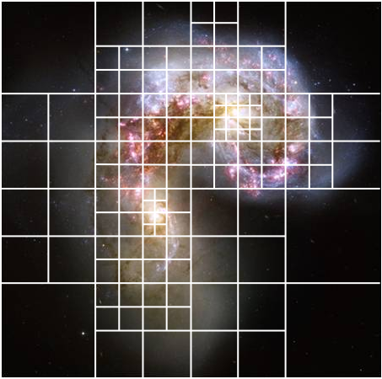
TASCEL-Dynamic Load Balancing
SPMD
Task
Parallel
Termination
SPMD
Express computation as collection of tasks
Tasks operate on data stored in PGAS (Global Arrays)
Executed in collective task parallel phases
TASCEL runtime system manages task execution
Load balancing, locality optimization, etc.
Extends Global Arrays’ execution model

Slide 124
Global Pointer Arrays
Create arrays where each array element can be an arbitrary data object
May be more limited in Fortran where each array object might need to be restricted to an arbitrarily sized array of some type
Access blocks of array elements or single elements and copy them into local buffers using standard put/get syntax
Potential Applications
Block sparse matrix
Embedded refined grids
Recursive data structures

Slide 125
Global Pointer Arrays (cont.)
Pointer Array
Pointer Array Data

Slide 126
Global Pointer Arrays (cont.)
[ ]
P_{i}

Slide 127
Fault Tolerance
Application
Domain Science
Data Redundancy/Fault Recovery Layer
Non-MPI TCGMSG
Global Arrays
Fault Resilient ARMCI
Fault Tolerant Barrier
Fault Resilient Process Manager
Fault Tolerance Management Infrastructure
Non-MPI message passing
Network

Slide 128
Fault Tolerance (cont.)
Exploration of multiple data redundancy models for fault tolerance
Recent demonstrations of fault tolerance with
Global Arrays and ARMCI
Design and implementation of CCSD(T) using this methodology
Ongoing Demonstrations at PNNL booth
Future ongoing developments for leading platforms
Cray and IBM based systems

Slide 129
Exascale Challenges
Node architecture will change significantly
Multiple memory and program spaces
Develop GA support for Hybrid Platforms
Small amounts of memory per core forces the use of non-SPMD programming/execution models
Thread safety - support for multithreaded execution
There’s not enough memory (or memory bandwidth) to fully replicate data in private process spaces
Distributing GA metadata within nodes
Greater portability challenges
Refactoring ARMCI

Slide 130
Exascale Challenges
Much shorter mean time between failures
Fault tolerant GA and ARMCI
Likely traditional SPMD execution will not be feasible
Programming models with intrinsic parallelism will be needed
MPI & GA in their current incarnations only have external parallelism
Data consistency will be more of a challenge at extreme scales

Slide 131
Scalability – GA Metadata is a key component
GA currently allocates metadata for each global array in a replicated manner on each process
OK for now on petascale systems with O(10⁵) processes
200,000 × 8 bytes = 1.5 MB per global array instance
Not that many global arrays in a typical application
Pointers to other processes global array portions
P0
P1
…
n entries on each process
…
Local global array portion owned by P0
Local global array portion owned by P1

Slide 132
Scalability – Proposed Metadata Overhead Reduction
Share metadata between processes on the same shared memory domain (today’s “node”)
Reduce metadata storage by the number of processes per shared memory domain
Shared Memory Domain
…
P0
Pointers to global array portions
P1
Local global array portion owned by P0
Local global array portion owned by P1

Slide 133
Summary
Global Arrays supports a global address space
Easy mapping between distributed data and original problem formulation
One-sided communication
No need to coordinate between sender and receiver
Random access patterns are easily programmed
Load balancing
High Performance
Demonstrated scalability to 200K+ cores and greater than 1 Petaflop performance
High programmer productivity
Global address space and one-sided communication eliminate many programming overheads

Slide 134
Thanks
DOE Office of Advanced Scientific and Computing Research
PNNL Extreme Scale Computing Initiative

Slide 135
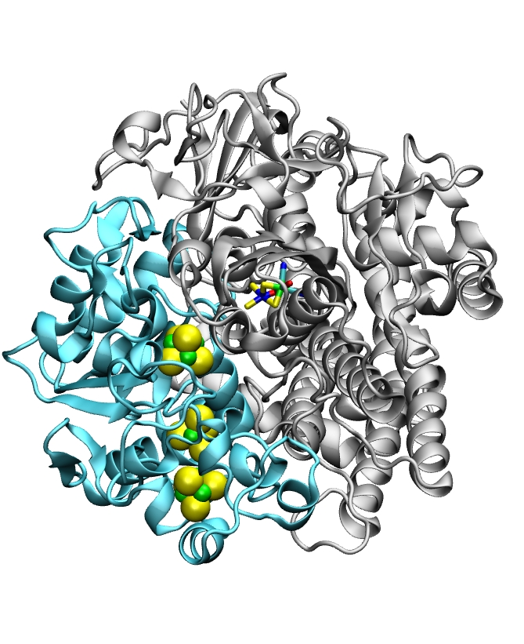
Discussion

